Slide 1
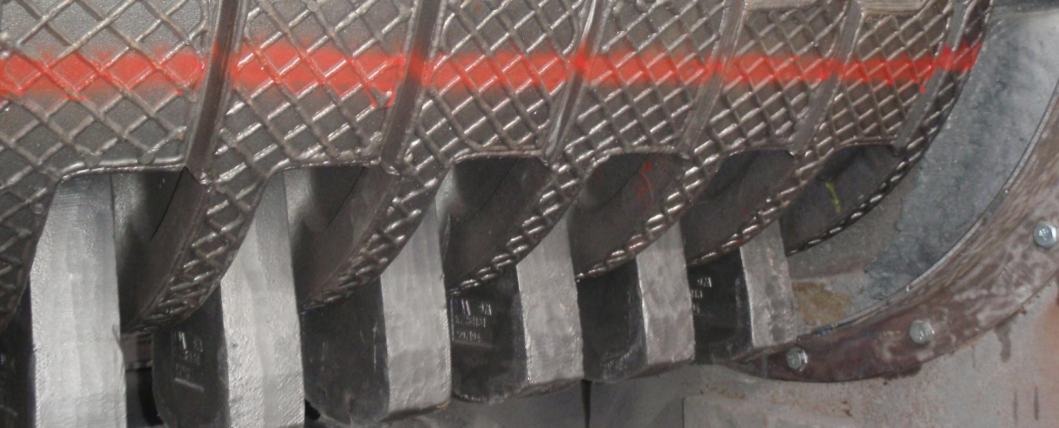
Crushing Tools Management
Technical Development Program for PPE, 2015-2016

Slide 2
Wear Management - Crushing
Introduction to Wear Management
2

Slide 3
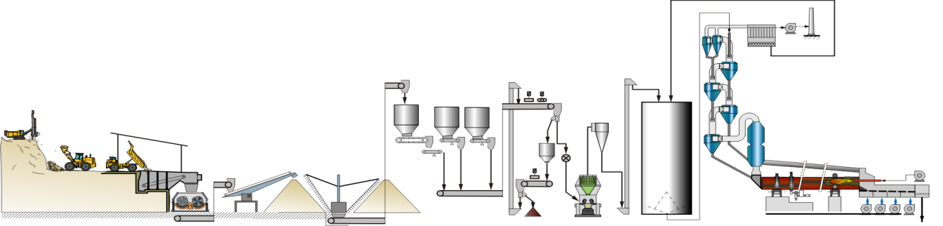
Why Wear Management?
Holcim prepares around 170 mio t/a of raw materials
Crusher and raw mill work as a team to transform rock size product into meal for the clinker production process
3

Slide 4
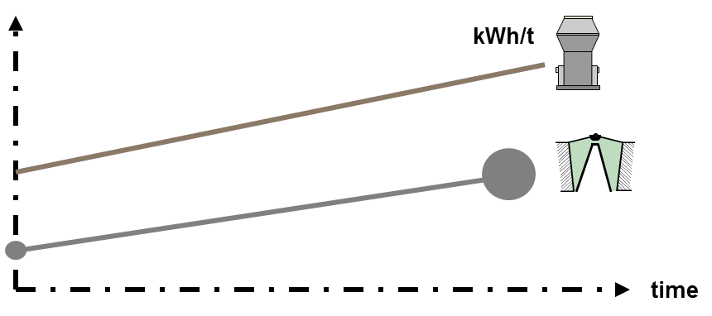
Wear & Electrical Energy Consumption
Both machines consume electrical energy and wear parts
Wear at the crusher results in coarser feed size for the raw mill and lowers its efficiency
1.7 kWh/t – 3.0 kWh/t
16kWh/t – 25 kWh/t
4

Slide 5
Potential Savings Through System Approach
Adequate selection of wear parts combined with a good wear parts management strategy of the crusher could
Decrease the specific wear rate at the crusher and associated maintenance costs
Increase the energy efficiency of the raw mill by around 5% or 1 kWh/t of raw material
5

Slide 6
Further Influence: Raw Material Extraction
To optimise the whole size reduction chain you have to include mining operations!
Blasting is the cheapest form of size reduction
Finer blast saves money on loading, hauling & crushing
Fragmentation is dependent of rock characteristics / geology
6

Slide 7
Wear Management - Crushing
Crusher Wear Parts
7

Slide 8
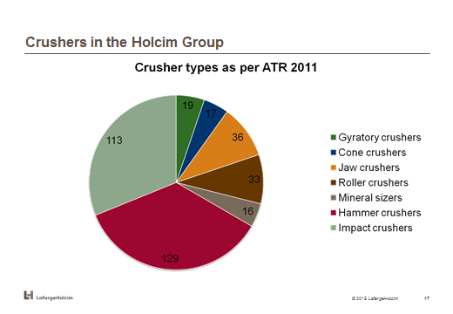
Significance of Crusher Wear Parts
Impact & hammer crushers are the most commonly used machines
Holcim spends around 20 mio CHF/a for crusher wear parts
8

Slide 9
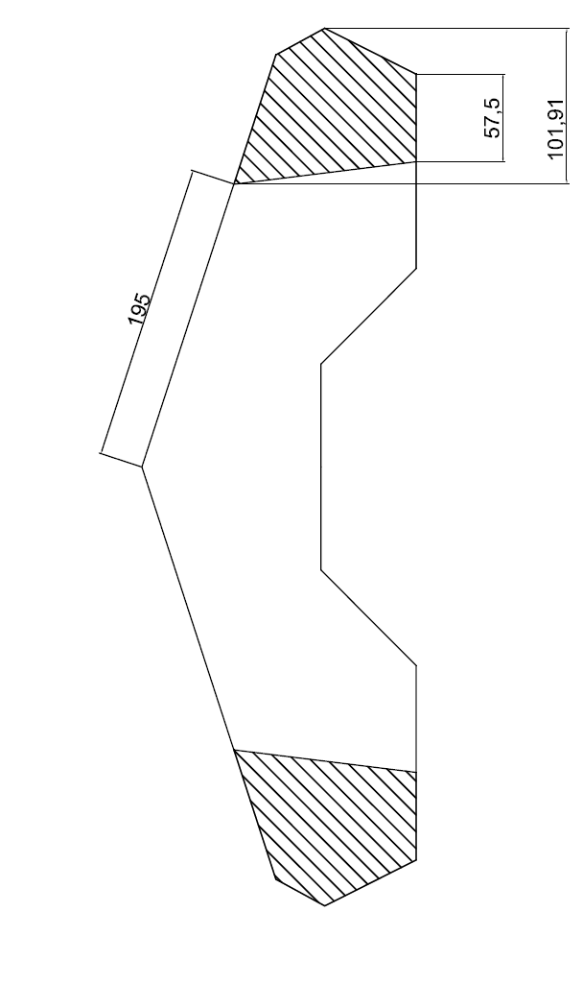
Wear Rates can be Expressed as NET or GROSS
Weight loss
Net wear =
(NW)
Production
Indicates the material abrasiveness
Initial weight
Gross wear =
(GW)
Production
What we pay
9

Slide 10
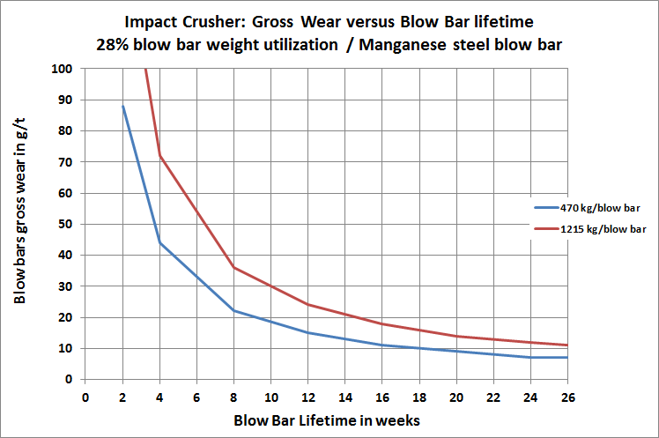
Correlation between Lifetime & Wear Rate
6 month lifetime of manganese steel blow bars of an impact crusher correspond to around 10 g/t gross wear rate
10

Slide 11
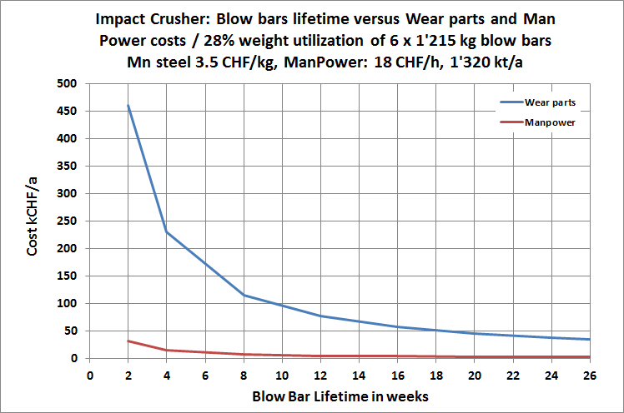
Direct Cost of Wear
With wear parts being the leading cost factor, the importance of proper material selection becomes evident
11

Slide 12
Wear Management - Crushing
Impact Crusher
12

Slide 13
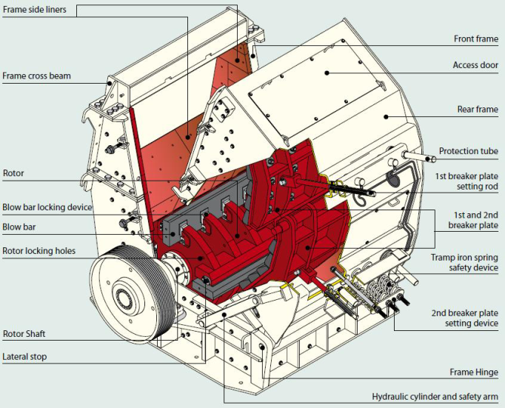
Impact Crusher
Typical material of blow bars: Manganese steel
13

Slide 14
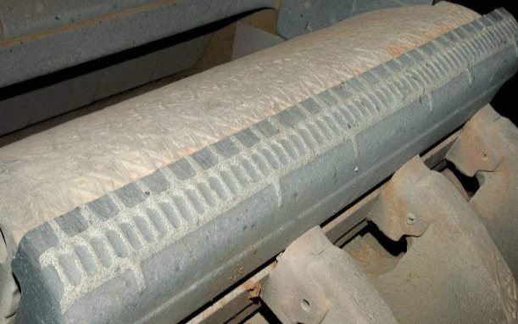
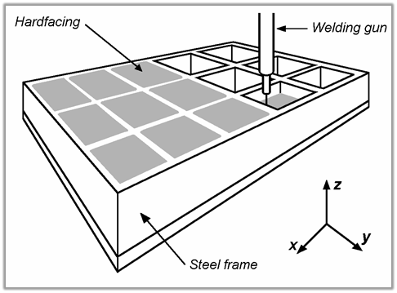
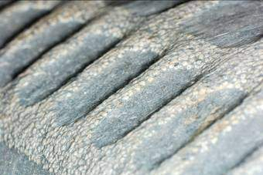
New Blow Bars Technology
Ceramic inserts on martensitic steel base
3D carbide on manganese steel base
Potential risk of inserts to break out from soft base
→ Increase of lifetime and product size control for the raw mill
14

Slide 15
Lifetime Factors for Blow Bars
Lifetime factor
Primary
Secondary & Tertiary
Manganese steel
1.0
1.0
Manganese Steel resurfaced
--
--
Martensitic steel
1.30 – 1.8
1.5 – 2.0
High Chrome cast
Not Applicable
1.5 – 2.0 (1)
Ceramic Inserts on martensitic steel
2.0 – 3.0
2.5 – 4.0
3D-Carbide on manganese steel base
~2.0 (2)
(3)
(1) Consistent performance over lifetime (reduced deformation)
(2) Results from initial tests
(3) No information available
15

Slide 16
Lifetime Influence through Blow Bar Design Modifications
The blow bar design could be modified from manufacturing in order to adapt to the wear profile over the lifetime
Allow for better product size control
Increased utilisation of the blow bar weight (reduced gross wear rate)
16

Slide 17
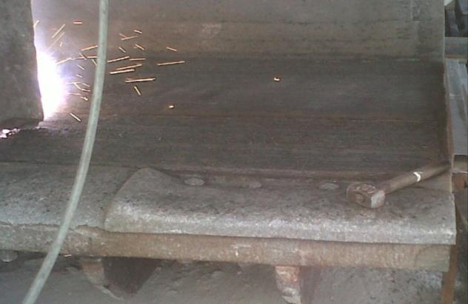
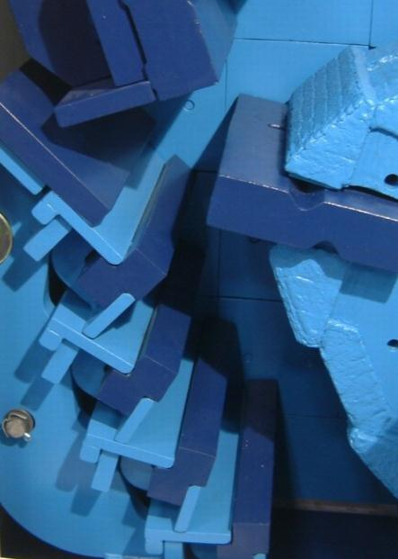
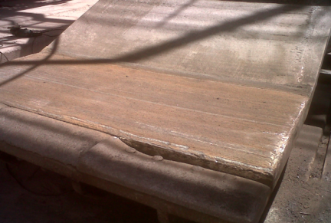
Breaker Plates and Grinding Path for Product Size Control
Breaker plates
Grinding path with wear resistant plates
17

Slide 18
Wear Management - Crushing
Hammer Crusher
18

Slide 19
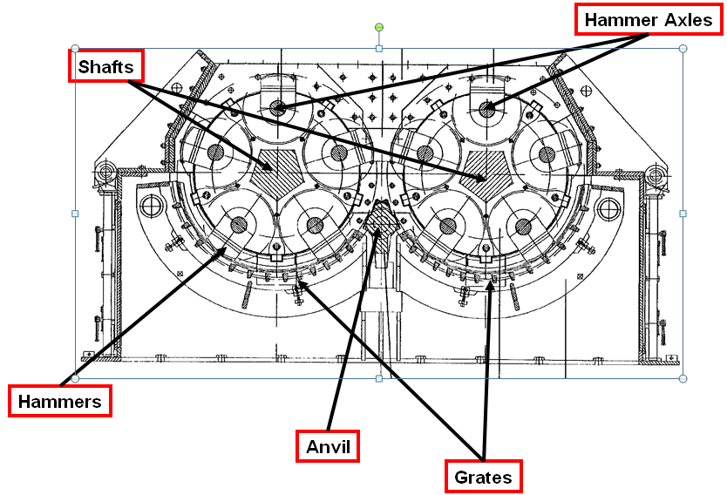
Hammer Crusher
Typical material of hammers: Manganese steel
19

Slide 20
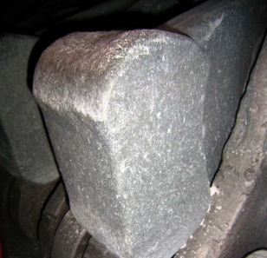
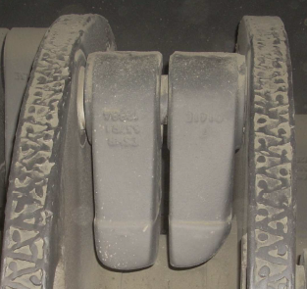
First Generation Hammer Improvements
Martensitic steel (differential heat treatment)
Head aimed at high wear resistance
Handle aimed at high resilience
Bimetal
Head: Wear resistant cast (high chrome)
Handle: Resilient steel
20

Slide 21
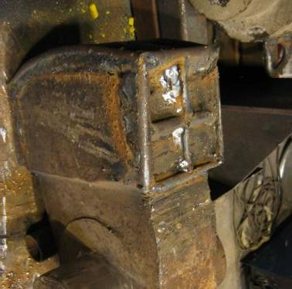
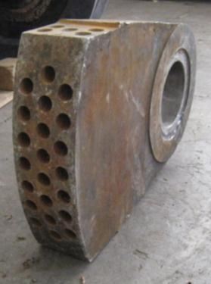
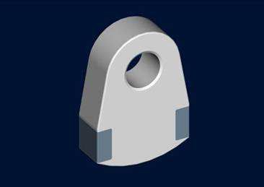
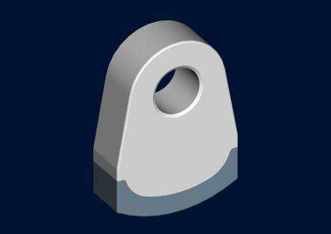
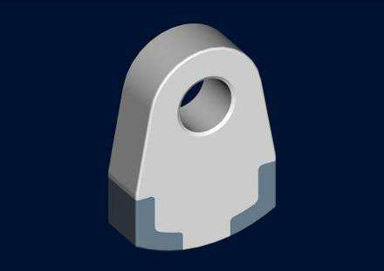
Latest Hammer Technologies
Ceramic inserts on martensitic steel base
3D carbide on manganese steel base
→ Flexible design to adapt wear resistance of the hammer to the actual wear profile and thus achieve increased lifetime
21

Slide 22
Lifetime Factors for Hammers
Lifetime factor
Primary
Secondary & Tertiary
Manganese steel
1.0
1.0
Manganese Steel resurfaced
1.1- 1.4
(2)
Martensitic Steel diff. heat treatment
1.3 – 2.3
1.5 – 2.0
Bimetal (High chrome cast head)
1.8 – 2.0
1.8 – 2.0 (1)
Ceramic Inserts on martensitic steel
2.0 – 4.0
2.0 – 4.0
3D-Carbide on manganese steel base
2 – 6 (1)
(2)
(1) More detailed investigations required for range clarification
(2) No information available
22

Slide 23

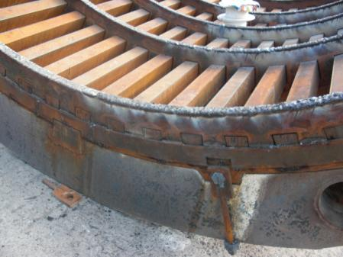
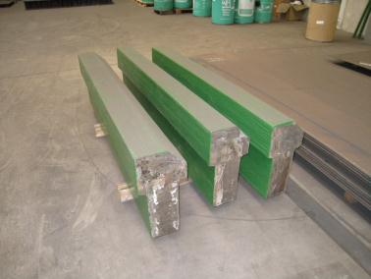
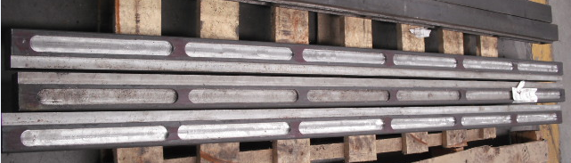
Anvil and Grates for Product Size Control
Resurfaced crusher basket edges
Anvils and crusher basket bars with 3D-Carbide
23

Slide 24
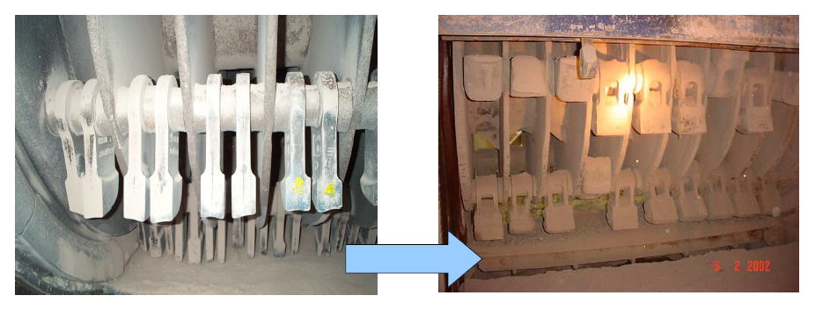
Lifetime and Throughput Influence by Hammer Design
Original
Modified
24

Slide 25
Wear Management - Crushing
Other Crusher Types
25

Slide 26
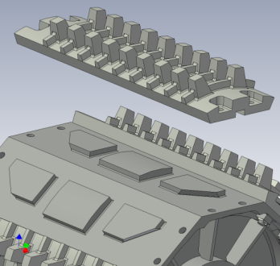
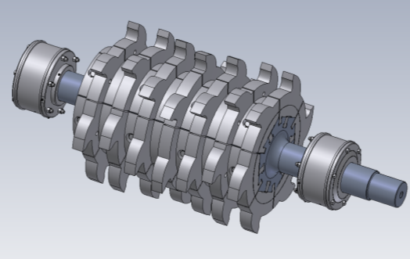
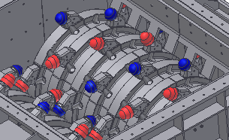
Double Roller Crusher
Replaceable plates
Replaceable inserts
Regular regeneration of teething through weld deposited material
Used solution is much dependent on crusher make
26

Slide 27
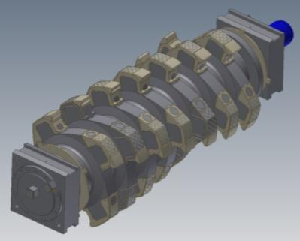
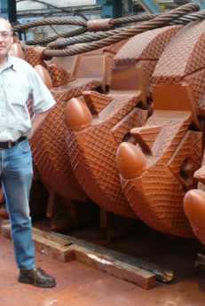
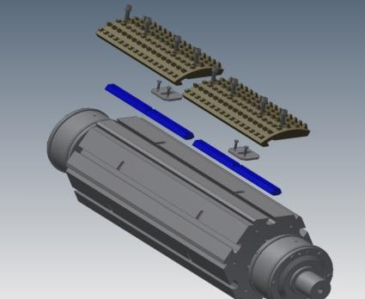
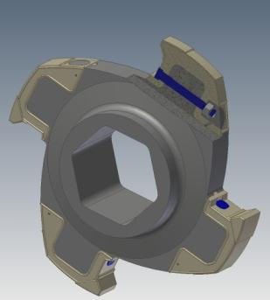
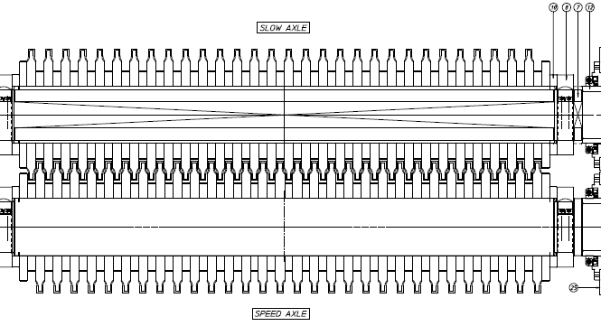
Mineral Sizer
Primary
Secondary
Hazemag (plates)
Exchangeable wear caps
Bedeschi (rings)
27

Slide 28
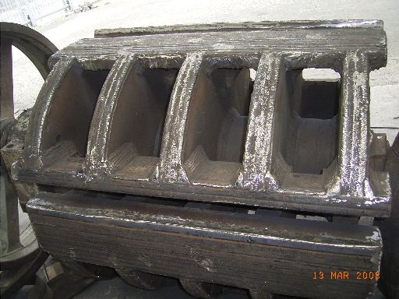
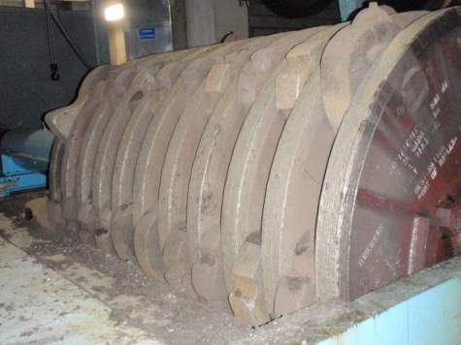
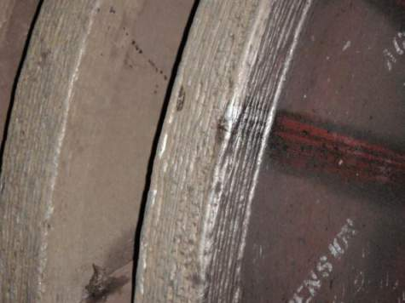
Rotor Wear Protection for IC / HC / DRC
Weld deposited wear resistant material to protect most exposed zones
28

Slide 29
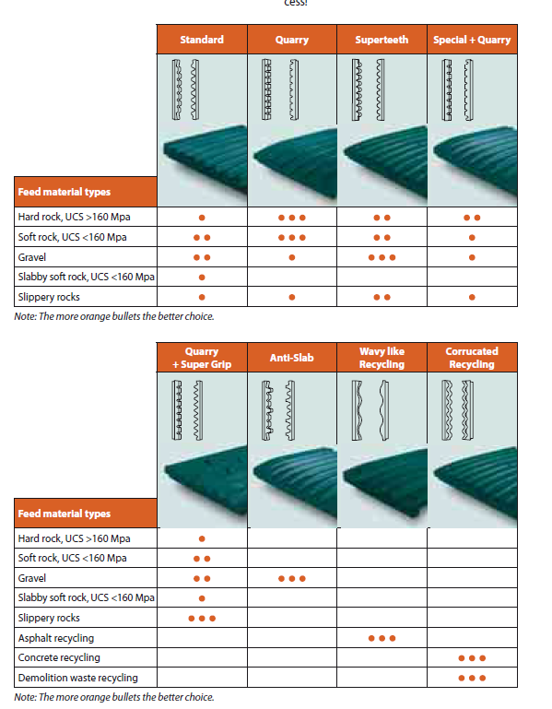
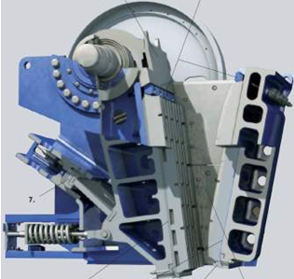
Jaw Crusher
Typical solution: Manganese steel plates combined with different plate geometries
Regeneration of plates at the lower part through weld deposited material is possible
29

Slide 30
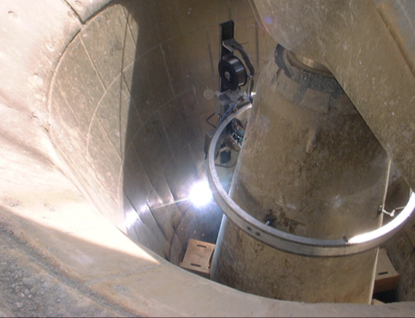
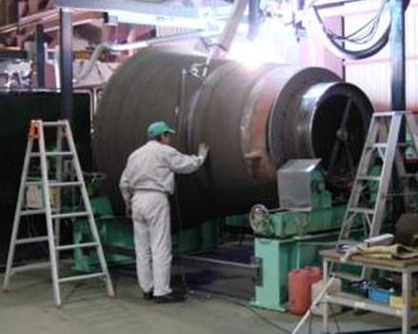
Gyratory Crusher
Mantle and concave liners are generally glued to shaft / shell
Refurbishing through welding is possible, but needs to consider impact on glue
On site or in workshop
Concave liner
Main shaft mantle
30

Slide 31
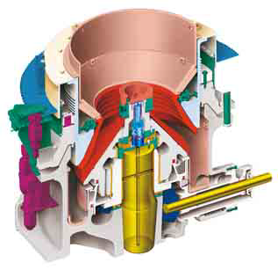
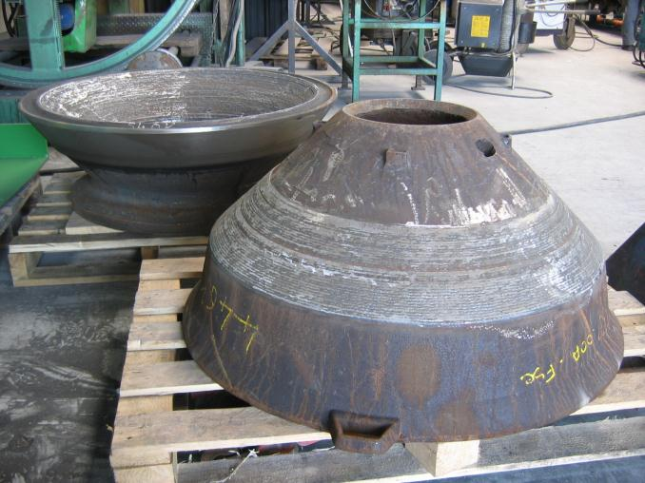
Cone Crushers
Cones can be rewelded or even equipped with 3D-Carbide
Generally they are replaced due to size and cost
31

Slide 32
Summary
Crusher and raw mill have to be optimised as one system
Wear at the crusher has an influence on the raw mill
Decreased throughput
Increased electrical energy consumption
Decreased reliability / stability
Most crushers still use locally manufactured manganese steel parts
Latest technology crushing tools can lead to substantial savings in
Wear parts cost
Electrical energy for raw grinding
Maintenance work
32

